Slide 1

Escaping the Loop: Re-imagining Spotify Music Discovery
Building the AI-Native Discovery Co-Pilot to Reduce Repetitive Listening Behavior
Prepared by: Growth Team Product Manager Supporting Artifacts Hyperlinked Inside

Slide 2
Aesthetic Fatigue Drives Premium Churn and Stagnates Engagement
The Discovery Paradox
• A significant share of streams originates from repeat playlists, familiar artists, and previously discovered songs.
• Hyper-personalization is generating closed 'filter bubbles' where algorithms play safe, identical subsets of user libraries.
• Users actively seek discovery but retreat to repetitive habits due to high curation friction and black-box layouts.
• Solving this unlocks organic virality (sharing new finds) and mitigates customer retention threats.
The Churn Threat
• Daily Premium listeners experience 'aesthetic boredom' from repetitive loops, motivating them to switch to competitors (Apple Music, YouTube Music) or search manually on Bandcamp/SoundCloud.
The AI-Native Solution
• Move away from passive recommendation structures. Give users interactive inputs (Discovery Intensity dial and Niche Boost filters) back-ended by LLM-semantic matching to rebuild platform trust.

Slide 3
User Reviews Reveal Polarized Sentiment Driven by Shuffle Loops and Ad Friction
Feedback Overview
55%
Positive Sentiment (Vast library catalog, concept satisfaction)
35%
Negative Sentiment (Shuffle repetition, smart shuffle bias, ads)
Dominant Review Themes & Core Complaints
• The Shuffle Loop: Users report that even with 1,000+ song playlists, the shuffle feature cycles through the 'same fifty songs' repeatedly, ignoring saved gems.
• Smart Shuffle Intrusion: Free and paying users criticize Smart Shuffle for injecting unwanted, repetitive pop songs that clash with the playlist's specific vibe.
• UI Overload: Intrusion of non-music content (podcasts, audiobooks) on the home screen increases browsing friction and drives users to loop cached favorites.
• Review Analysis Workflow: Supported by our dynamic analysis workspace.
Read Full Feedback Database and PM Report: analysis_report.md

Slide 4
Curators and Specialists Face Different Discovery Barriers
Sarah, 28 The Playlist Curator
• Manages massive custom playlists (1,500+ tracks).
• Frustration: Shuffle loops on a tiny fraction of songs. Smart Shuffle injects commercial pop that ruins the vibe.
• Workaround: Uses Shazam in public or scans external blogs, then manually inputs songs to Spotify.
Marcus, 34 The Genre Specialist
• Listens to niche genres (ambient electronica, indie jazz).
• Frustration: Spotify recommends generic, major-label crossover pop. AI DJ transitions are jarring and disrupt flow.
• Workaround: Discovers new music on Bandcamp/SoundCloud, then streams on Spotify only as player.
Priya, 22 The Casual Discoverer
• Relies on background music (Daily Mixes) for focus.
• Frustration: Daily Mixes become static loops repeating liked songs instead of suggesting new releases.
• Workaround: Overcome by decision fatigue, she accepts repetitive streams because active discovery is painful.
Access Primary Research and Interview Transcripts: user_research_validation.md

Slide 5
Algorithmic Feedback Loops and UX Clutter Root Cause Stagnation
1. Technical Drivers
• Collaborative Filtering Lock-in: Matrix factorization treats historical listens as permanent preference, trapping user vectors in tight local sub-clusters.
• Shuffle Optimization: Uses local caching and affinity bias instead of true randomness to reduce streaming server requests.
2. UX / Design Drivers
• The Black-Box Interface: Recommendations offer zero sliders to modify the novelty vs. familiarity ratio.
• Home Screen Clutter: High-visibility rows are loaded with podcasts and audiobooks, increasing search cost and driving users to loop downloaded tracks.
3. Commercial Drivers
• Label Payola placements: Smart Shuffle algorithms boost sponsored releases via marketing distribution deals.
• Royalty Cost Structure: Heavy streaming of major-label pop catalog incurs high licensing margins, disincentivizing organic long-tail discovery.

Slide 6
Retaining Bored Subscribers and Shifting Stream-Share Optimizes Gross Margins
Protecting Premium Churn
Aesthetic fatigue is a top reason premium users churn. Reducing monthly subscriber churn by 0.1% across 240M premium users yields a run-rate increase of ~$34.5 Million in Annual Recurring Revenue (ARR).
Content Royalty Optimization
Streaming major-label pop hits carries expensive minimum payout thresholds. Distributing 400 bps of stream share to independent, long-tail artists via niche discovery features improves Spotify's gross margins on content licensing.
The Strategic Loop: Trust, Engagement, and Virality
• Restoring Recommendation Trust: Showing users why songs are recommended stops them from turning to Bandcamp or SoundCloud.
• Organic Growth Loop: Listeners who discover obscure local talent share tracks on social platforms, creating a low-cost organic acquisition engine.

Slide 7
Generative AI Unlocks Semantic Matching and Multi-Constraint Controls
Traditional Recommender Systems
• Vector Correlation Bubble: CF matches user profile lookalikes. Recommends songs similar listeners heard, leading to high repetition.
• Keyword Restrictions: Search requires hard metadata matches. Fails on abstract searches (e.g. 'moody synth for rainy night in Paris').
• Black-Box Placement: Recommendations are static queues. No user knobs to scale novelty or filter label commercial content.
AI-Native Co-Pilot
• Semantic Search Mapping: Multi-dimensional embedding maps abstract vibe descriptions to sonic profiles containing detailed texture descriptions.
• Multi-Constraint Reasoning: Interprets natural language vibe + novelty dial + Niche Boost settings simultaneously to build custom play queues.
• Transparent Rationales: Explains exactly why each track is recommended, restoring user trust and encouraging exploration.

Slide 8
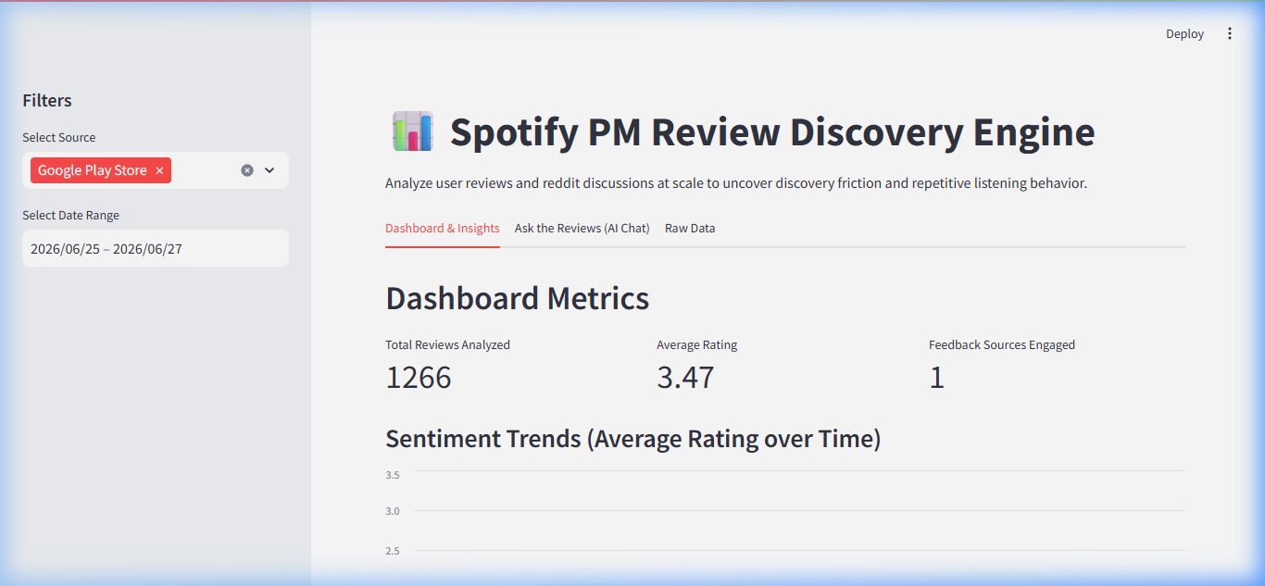
The AI-Powered Review Analysis Engine Ingests, Normalizes, and Summarizes Feedback
Review Analysis Workflow (PM tool)
1. Scraping Engines: Automated scripts scrape App Store and Google Play reviews, filtering for feedback within the last 12 months.
2. Normalizer Module: Deduplicates reviews, aligns schemas, and removes entries under 10 characters to filter out noise.
3. LLM Pipeline: Feeds normalized reviews to Gemini with structured PM prompts to cluster themes, personas, and JTBDs.
4. Ask the Reviews Chat: Integrates a Q&A chatbot allowing product managers to query the feedback database in plain language.
Test out the Workflow: PM Review Dashboard (Port 8501)

Slide 9
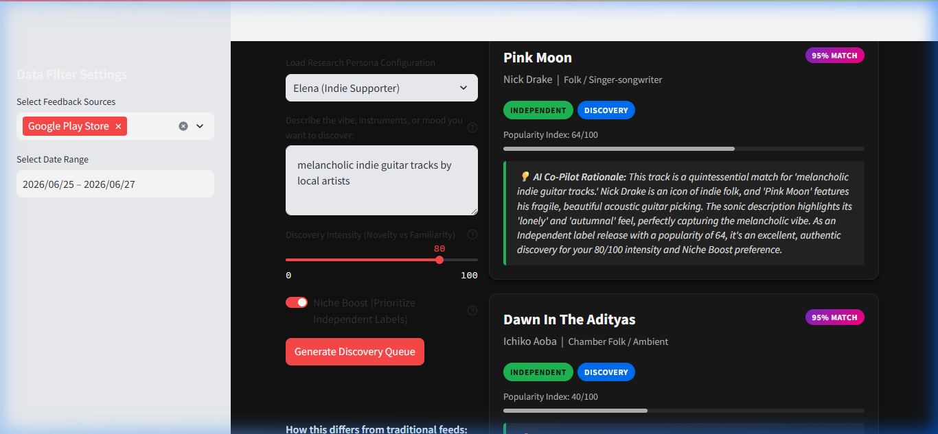
Our Live Standalone Co-Pilot MVP Empowers Active Novelty Tuning
Co-Pilot Interactive Tuning Features
• Vibe Description Input: Users describe a mental state or scene. LLM handles semantic cross-references against track details.
• Discovery Intensity Slider: Select 0% for familiar hits, 50% for balanced mixes, or 100% to explore highly obscure independent music.
• Niche Boost Switch: Active filter that prioritizes independent releases (< 65 popularity index) over commercial pop.
• Transparent Explanations: Each track displays an explanation detailing how its tempo, rhythm, or instruments fit the vibe.
Play with the Live Prototype: Discovery Co-Pilot (Port 8502)

Slide 10
We Will Measure the Stream Diversity Index to Validate Retention Impact
Key Metrics for Success
• Stream Diversity Index (North Star): Gini coefficient of artists played per user over a 30-day period. Target: Reduce Gini concentration by 15% (more equal share).
• Recommendation Save Rate: Percentage of recommended tracks saved to 'Liked Songs' or custom playlists. Target: Increase from ~3% to 8%.
• Discovery Share of Streams: Percentage of total streams coming from co-pilot queue vs. user library. Target: 35%.
• Churn Mitigation: 5% churn reduction among target cohort.
Deployment & Roll-out Strategy
• Phase 1: A/B Testing (Weeks 1-4) Deploy Co-Pilot to a 5% cohort of premium subscribers exhibiting high boredom signals (declining listening hours, repeated skips).
• Phase 2: Regional Alpha (Weeks 5-8) Expand release to a specific region (e.g. US West or India) to test server/LLM latency, embedding API costs, and load capacity.
• Phase 3: Global Beta Integration (Week 9+) Merge controls directly under the standard 'Search' or 'AI DJ' feed, replacing Smart Shuffle entirely.

